Slide 1
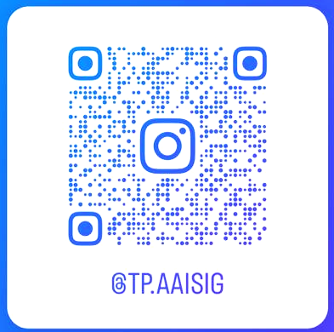
AAISIG AWS Cloud Computing Workshop
21 July 2023 | 1 pm - 3pm

Slide 2
Today’s Agenda
Workshop Setup Debugging
Introduction to Cloud Computing & IaC
Start of Project A
Start of Project B
Cleaning up Infrastructure & Closing Account
End of Workshop

Slide 3

Workshop Setup Debugging
Portion is for those who have encountered issues completing the provided start-up guide
Setup Unattempted → Please complete it NOW ASAP
Setup Attempted AND
Success → Remain in main call & listen to presentation
Failed AWS Set Up Portion → Added into Breakout Room 1
Failed Visual Studio Code Set Up Portion → Added into Breakout Room 2
Failed Terraform Set Up Portion → Add into Breakout Room 3
We will ask you to RAISE YOUR HAND when calling for those who have failed each portion so we can add you to the breakout rooms. If there are too many of you, please be patient.

Slide 4
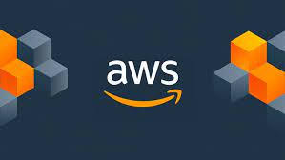
Introduction - What is Cloud Computing?
Cloud computing refers to the delivery of computing services over the internet, enabling convenient access to a shared pool of configurable computing resources. It involves the use of remote servers hosted on the internet to store, manage, and process data, rather than relying on local servers or personal devices.
TLDR: Think of it as the lending or provision of computing power and services from a cloud provider (like AWS).
Amazon Web Services (AWS) Our Cloud Provider for Today!

Slide 5
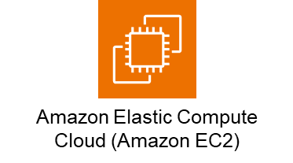
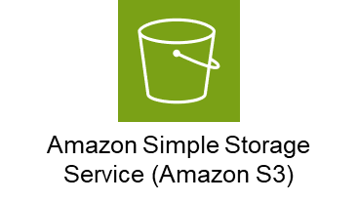
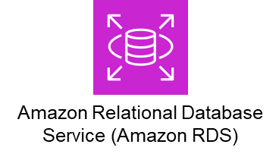

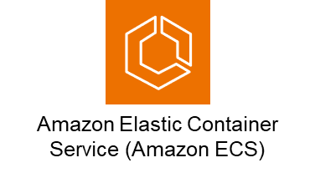
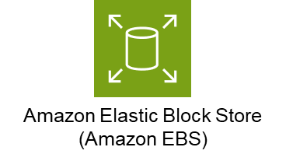
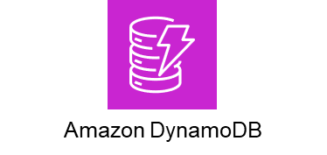
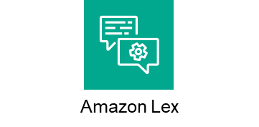
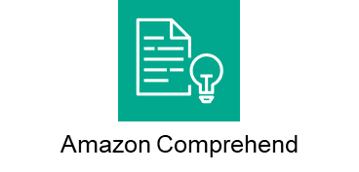
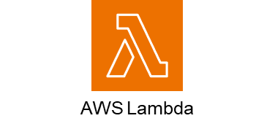
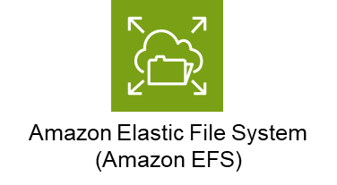
Introduction - What can we “borrow” from the Cloud?
Virtual Machines
Storage Services
Database Hosting
AI Services

Slide 6

Introduction - What is Infrastructure as Code (IaC)?
Infrastructure as Code (IaC) allows you to define and manage infrastructure resources using code. Instead of manually configuring and provisioning infrastructure components, such as servers, networks, and storage, IaC enables you to declare the desired state of your infrastructure using code, and then use automation to provision and manage those resources.
TLDR: Instead of using the AWS Web-based console to provision, we can instead use an IaC provisioning tool (like Terraform) to do it for us using code.
HashiCorp Terraform
Our IaC Tool for Today!

Slide 7
Introduction - Benefits of IaC
Automation
Single command for Cloud Infrastructure setup and teardown (Instantly showcase projects during interviews)
Scheduled auto Apply/Destroy for cost optimization during low traffic.
Documentation
IaC enables comprehensive Cloud Infrastructure documentation (Ideal for showcasing projects on GitHub or other repositories).
Collaboration
Real-time collaboration for simultaneous Terraform project development (Developers can collaborate efficiently on cloud projects).

Slide 8


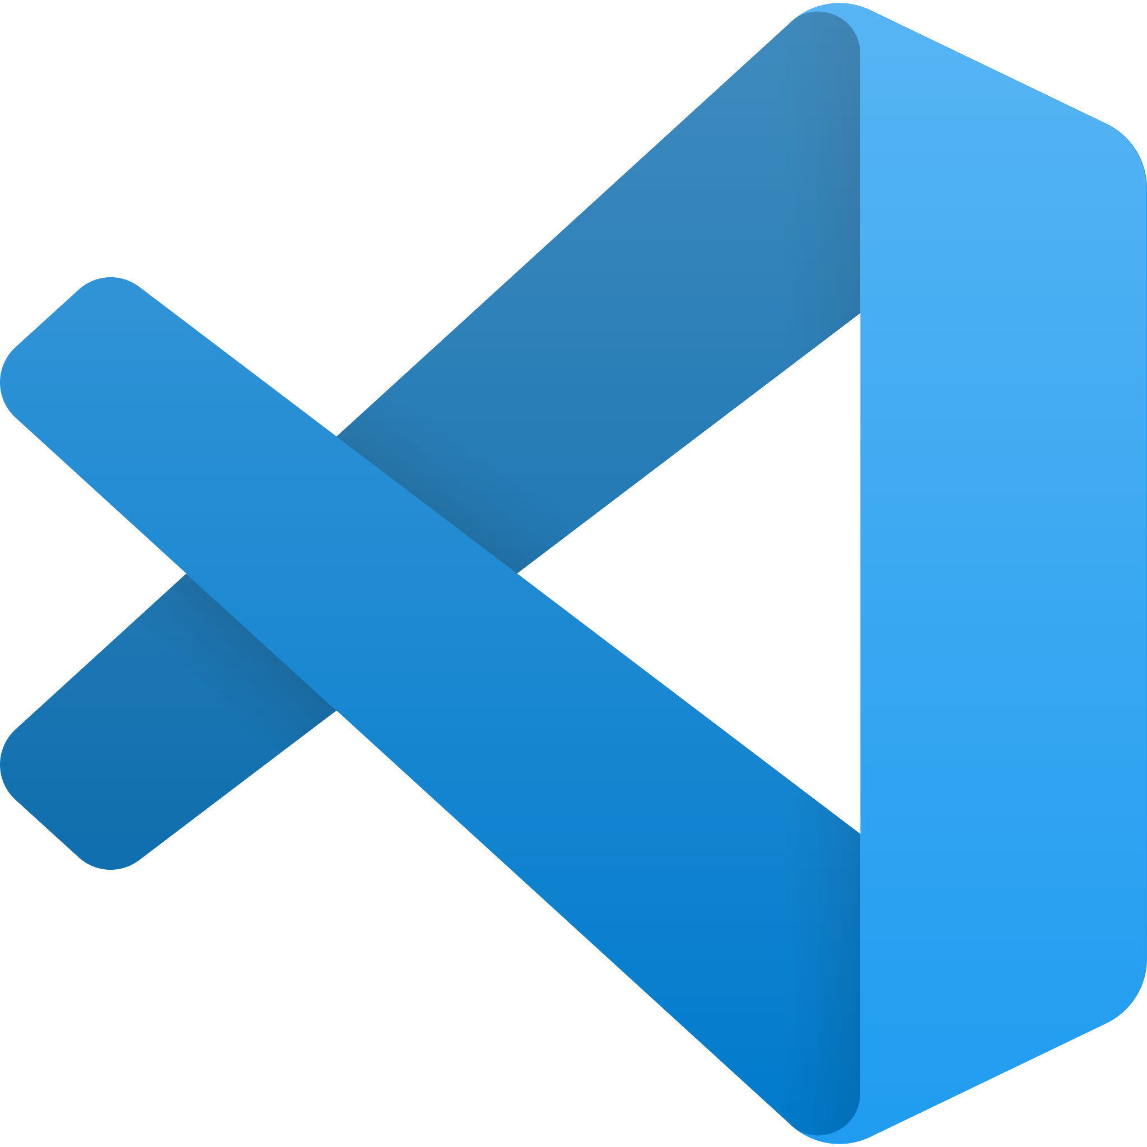
Introduction - IDE & Tools
Developer Environment Rundown
Command Prompt to run Terraform codes using commands
Visual Studio Code as the IDE to view and edit codes
Amazon Web Services as the Cloud Provider to lend us the Infrastructure
Command Prompt
Visual Studio Code
Amazon Web Services

Slide 9
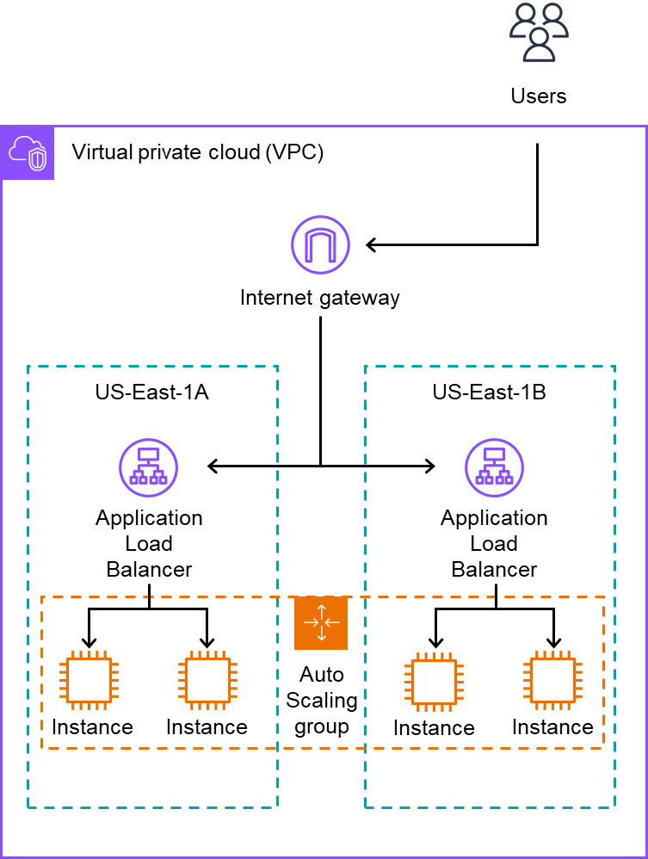
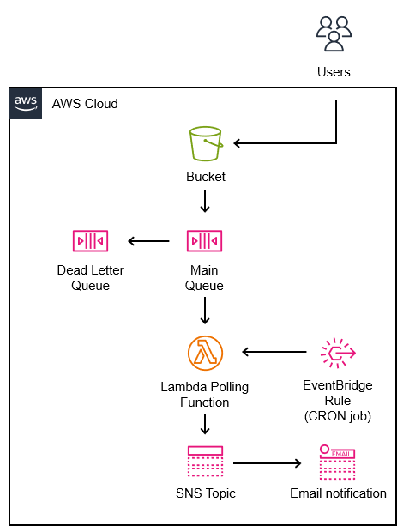
Introduction - Overview of Projects
Project A - Highly Available, Auto Scaling and Load Balancing Website
Project B - Storage Notification Email System with Message Queue Decoupling

Slide 10
Transition to Projects
That's the end of the Introduction!!!
We will wait for those debugging to join back into the main call before starting the Projects.

